Slide 1
Do’s And Don’ts of PPT
A Guide to Creating Effective and Engaging slides

Slide 2
Agenda
Definition of PPT
Do’s of PPT
Don’ts of PPT
Examples for Do’s and Don’ts of PPT
Email

Slide 3
PowerPoint Presentation
A PowerPoint presentation is a visual tool made with Microsoft PowerPoint, a software program in the Microsoft Office family. It’s used to show information on slides, helping speakers present their ideas clearly and effectively.
It is mainly used in Education, Business, Organization, Marketing, Conferences
What it is?

Slide 4

Do’s
Colors
Bullets
Concise and to the point
Dark letters on light background
Use Bullet Points, Limit it to 6
Keep text concise and to the point
Order
Visuals
Provide valid info
Organize your slides in order
Make it visually Interesting
Make sure that Information is correct

Slide 5

Don’ts
20XX
Overloaded Text
Style and Size
Low resolution Images
Avoid too much text in one slide
Avoid multiple fonts size, styles
Avoid irrelevant images
Distracting Background
Inconsistent format
Uppercase letters
Don’t use distracting background
Formatting matters
Don’t use all uppercase letters

Slide 6
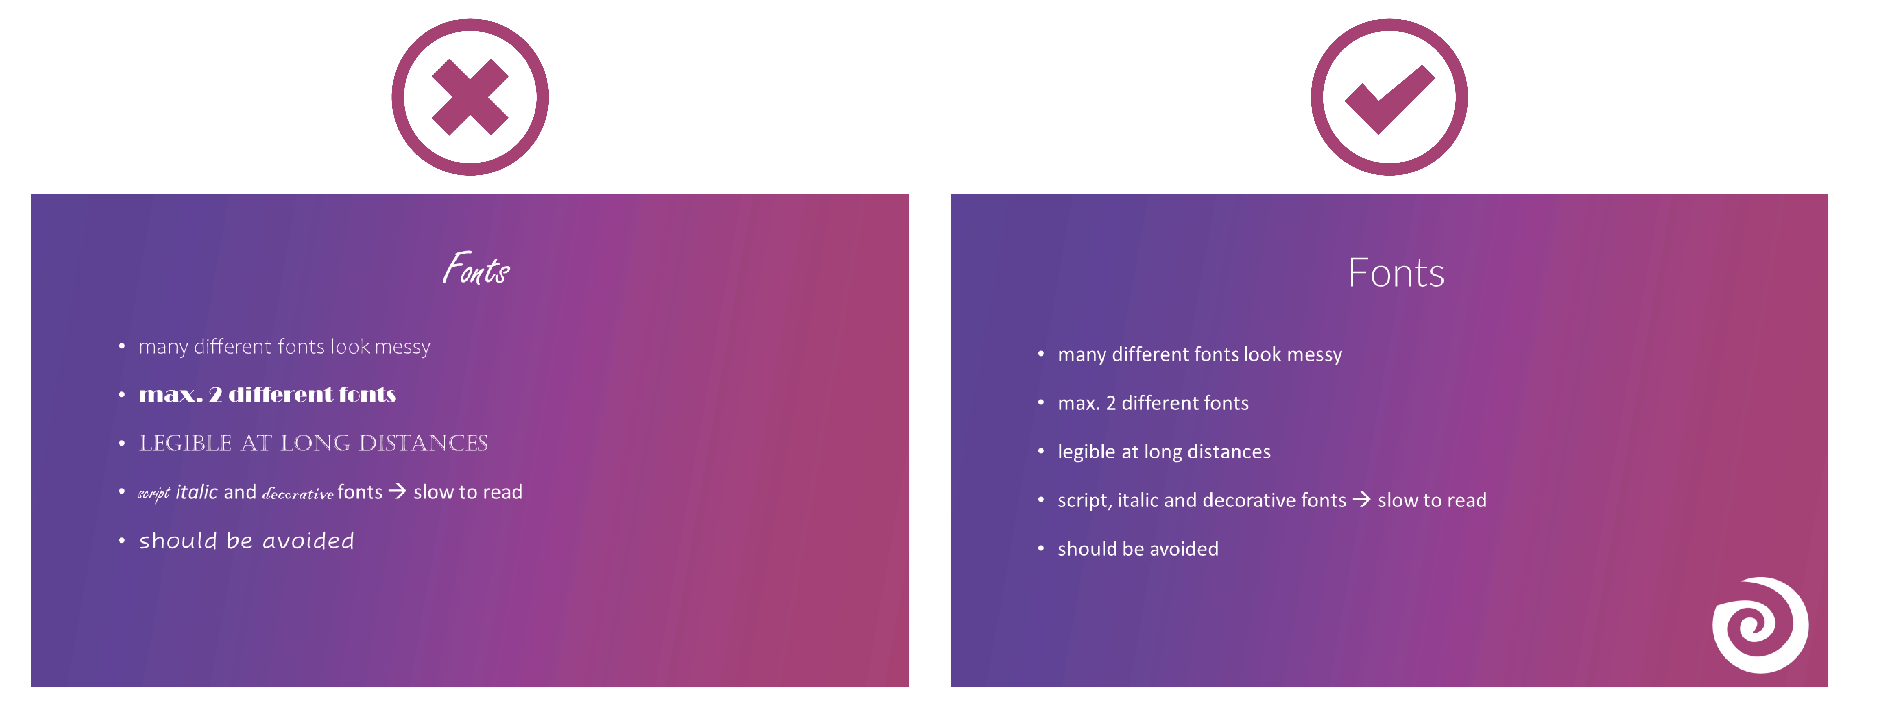
20XX

Slide 7
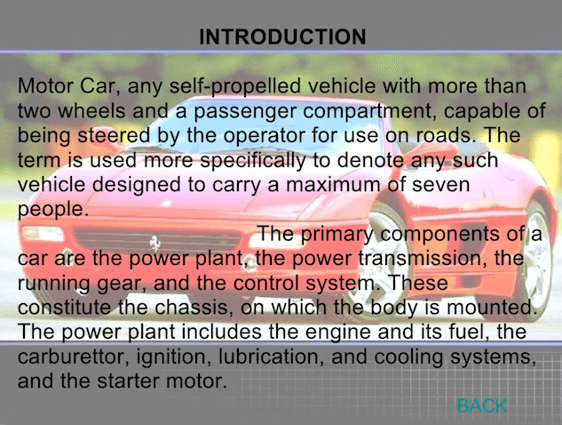
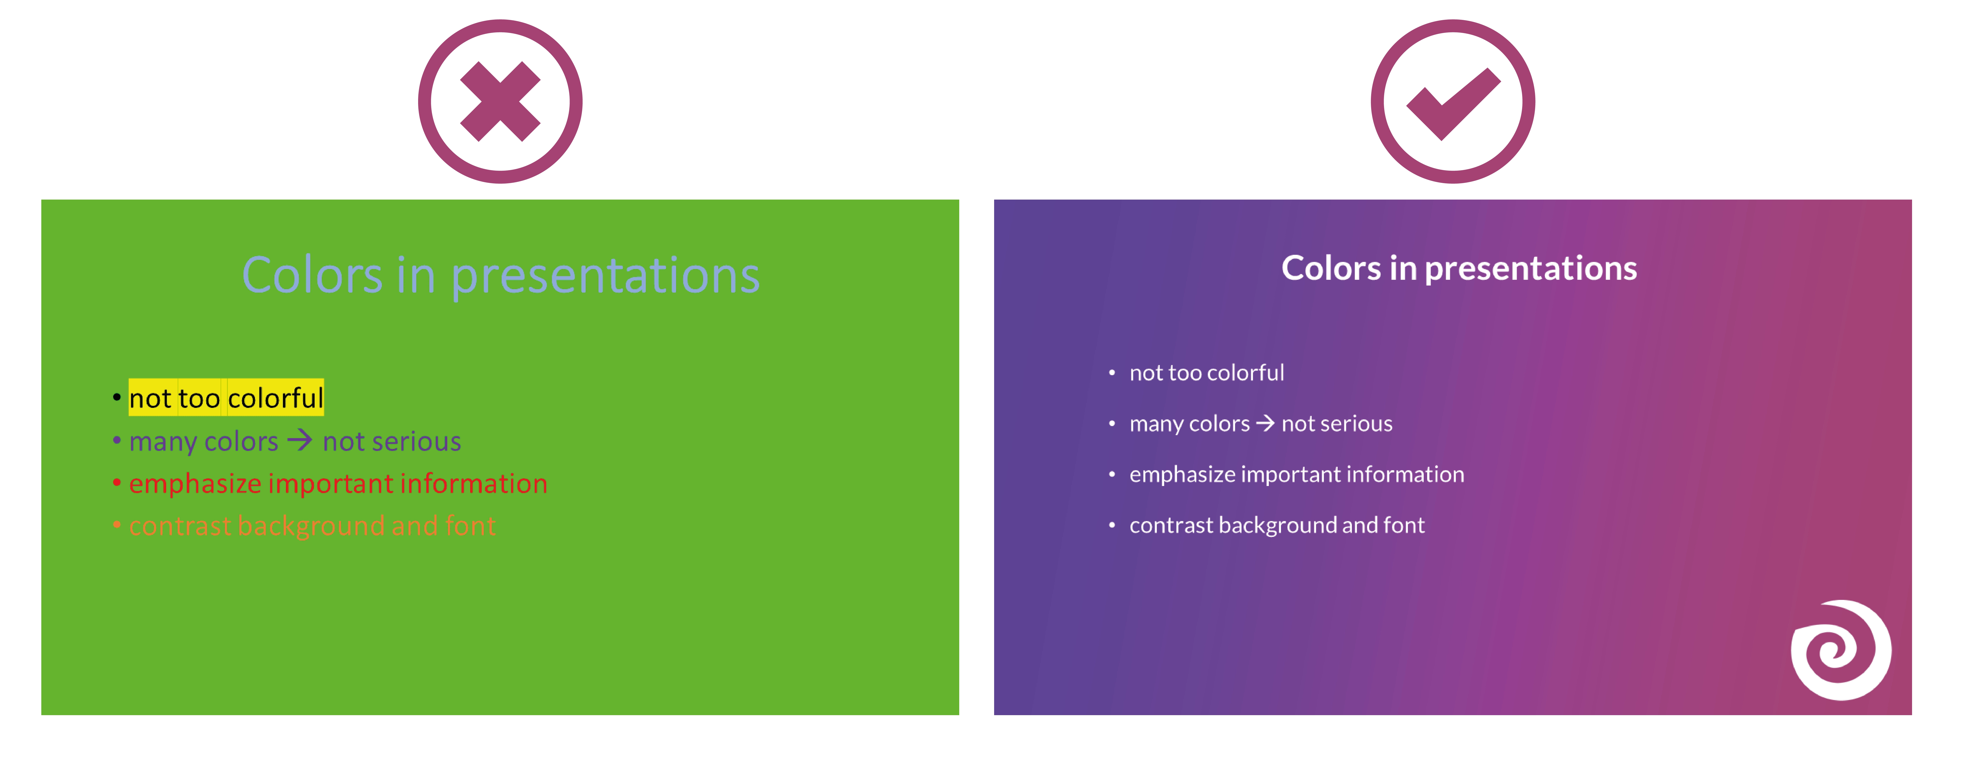
20XX

Slide 8
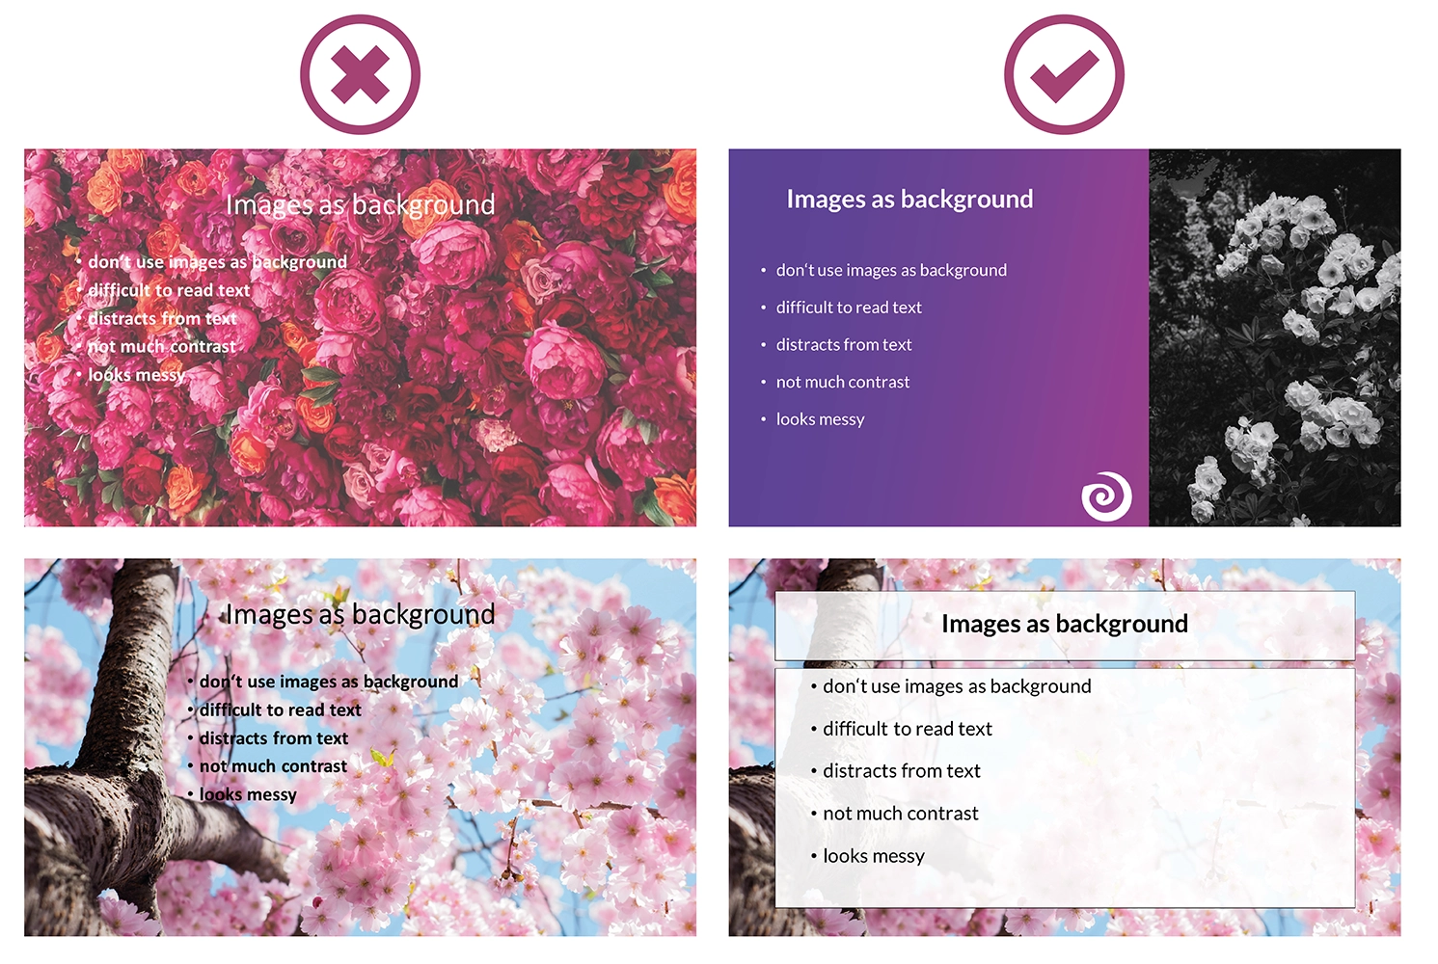
20XX

Slide 9
Email :
Subject: Do’s and Don'ts for PowerPoint Presentation
Hi Taks,
I hope this email finds you well. I wanted to share some essential dos and don'ts for creating effective PowerPoint presentations.
These guidelines apply to anyone preparing a presentation, whether for school, work, or public speaking. The key dos include keeping slides simple, using high-quality images, readable fonts, and concise text, maintaining a consistent design, practicing beforehand, engaging with the audience, and using animations sparingly. Key don'ts to avoid are overcrowding slides, using too many fonts or colors, reading directly from slides, using distracting animations, and ignoring audience feedback.
These guidelines should be applied from the planning stage through to delivery, in any setting where PowerPoint is used. They are important because they help ensure clarity, maintain audience attention, and enhance the presenter’s credibility. To implement these tips, start with a clear outline, use templates for consistent design, rehearse thoroughly, and engage with your audience during the presentation.
Following these tips will help you create professional and effective presentations.
Best regards,
Nune Naresh

Slide 10
THANK YOU!
Nune Naresh

